Slide 1


Vinoba Bhave University Hazaribagh
IPL 2023 DATA ANALYSIS
Presented by
Guided by
Name: Sanket Kumar
Roll No.: 211809032244
Nishant Gupta Sir
Submitted for the partial fulfillment
of
Bachelor’s in Computer Application
in
University Department Of Computer Applications, V.B.U., Hazaribagh
University Department of Computer Applications V.B.U.
June - 2023

Slide 2
Content
Introduction
Objectives
Requirement
Data Set
Data Cleaning
Data Modeling
Data Analysis
Conclusion
References
Openers
Middle Order
Finishers
All Rounder
Bowler
IPL 2023 DATA ANALYSIS
June - 2023
2

Slide 3
1. Introduction
To analyze the performance of all players in IPL 2023 across all matches played, focusing on their batting and bowling capabilities.
To assess the overall impact of these players on their respective teams, taking into account their ability to perform under pressure and influence match outcomes positively.
To identify any patterns or trends among the top-performing players, such as their preferred batting or bowling positions, batting strike rate, bowling economy etc.
This Analysis may help to create new team in upcoming IPL seasons.
For achieve above goal (team) we define some interesting parameters…!
IPL 2023 DATA ANALYSIS
June - 2023
3

Slide 4
2. Objectives
First we collect the IPL datasets from different sources.
Cleaning the dataset because in dataset may be some error or wrong data and sometime we have some extra data which is not used in project.
We don’t know the strengths and weaknesses of our opponents but give me the best 11 from this season of IPL.
Defined various parameter to find best performer. Like Batting Avg >160, Bowling economy etc.
Some Parameter
The team should be able to score at least 200 runs on an average.
They should be to defend 180 runs on an average.
IPL 2023 DATA ANALYSIS
June - 2023
4

Slide 5
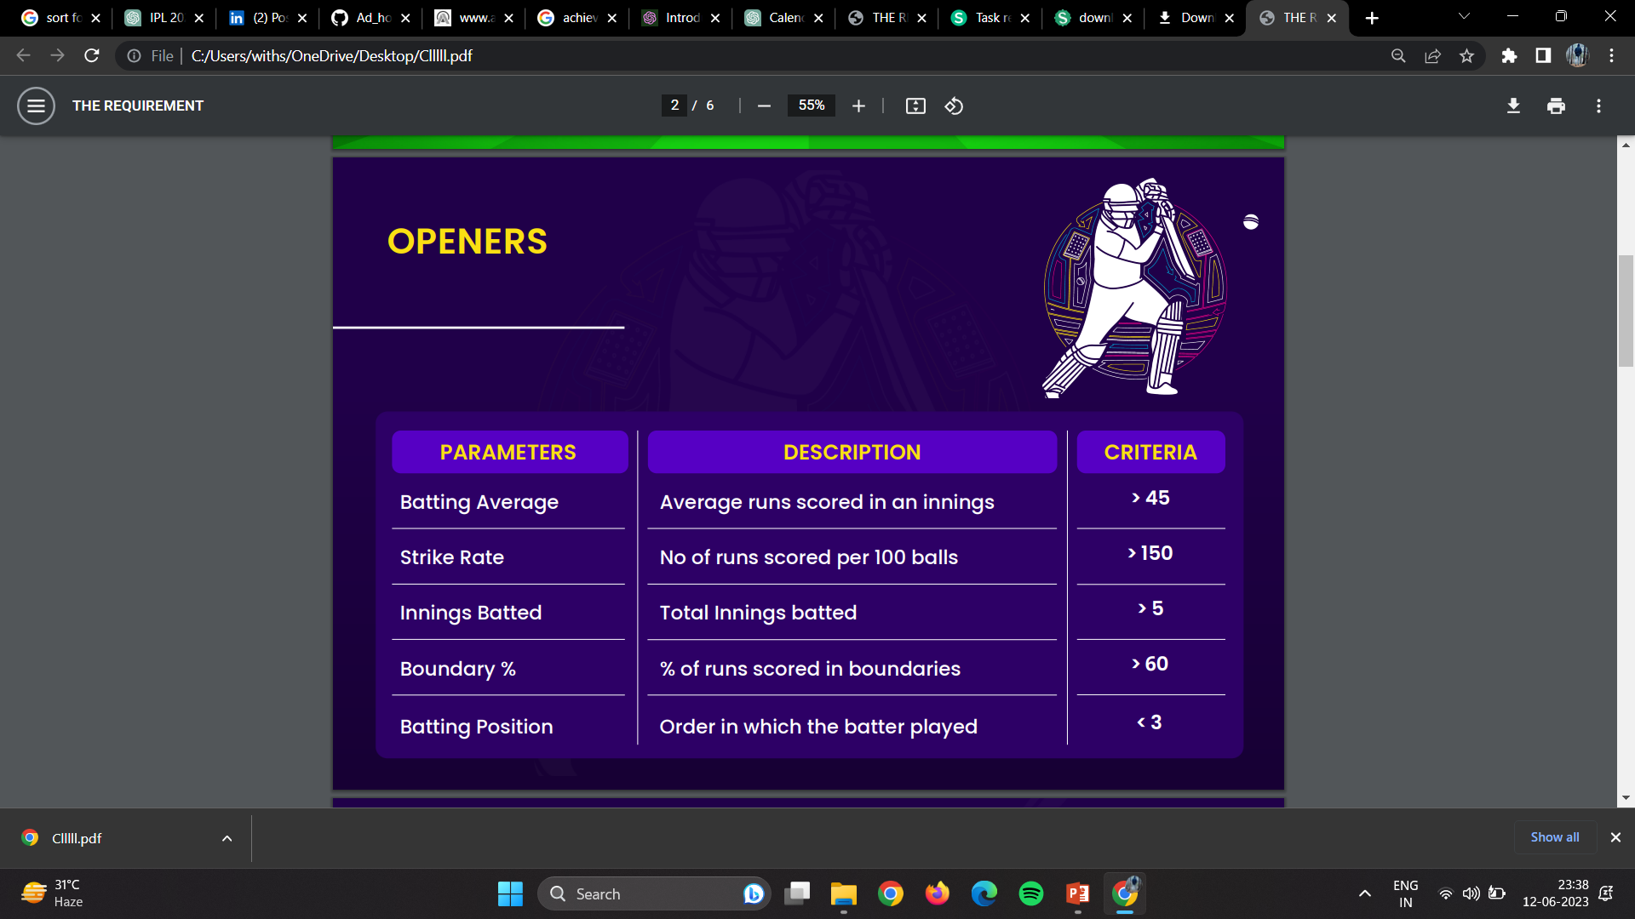
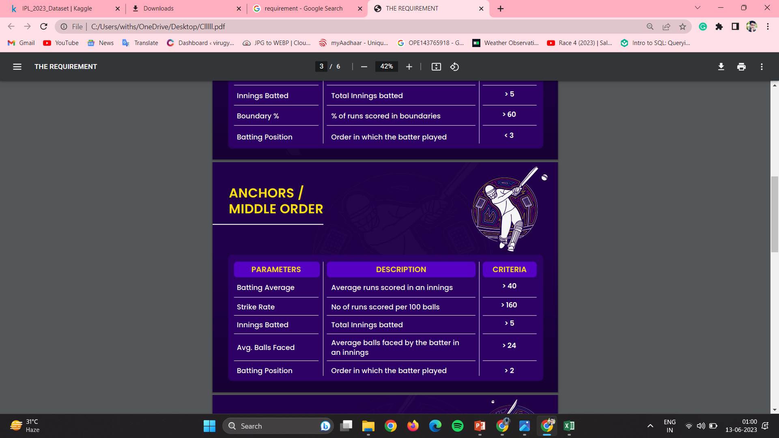
3. Requirement / Parameters
IPL 2023 DATA ANALYSIS
June - 2023
5

Slide 6
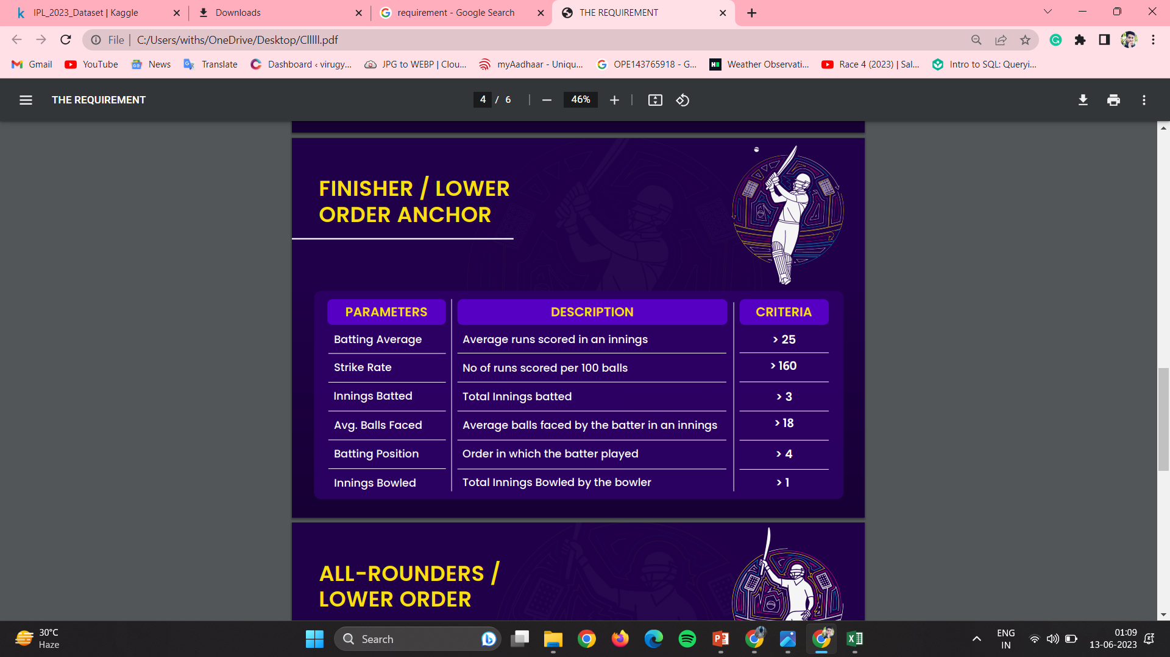
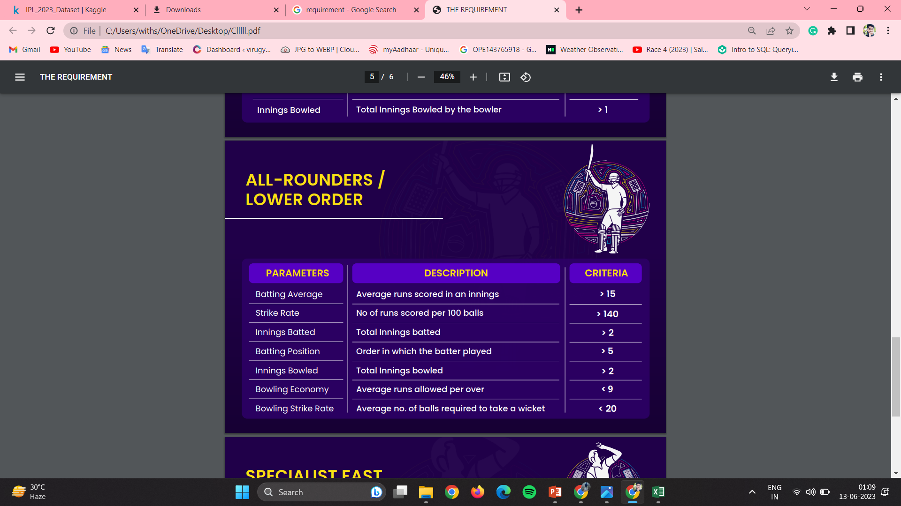
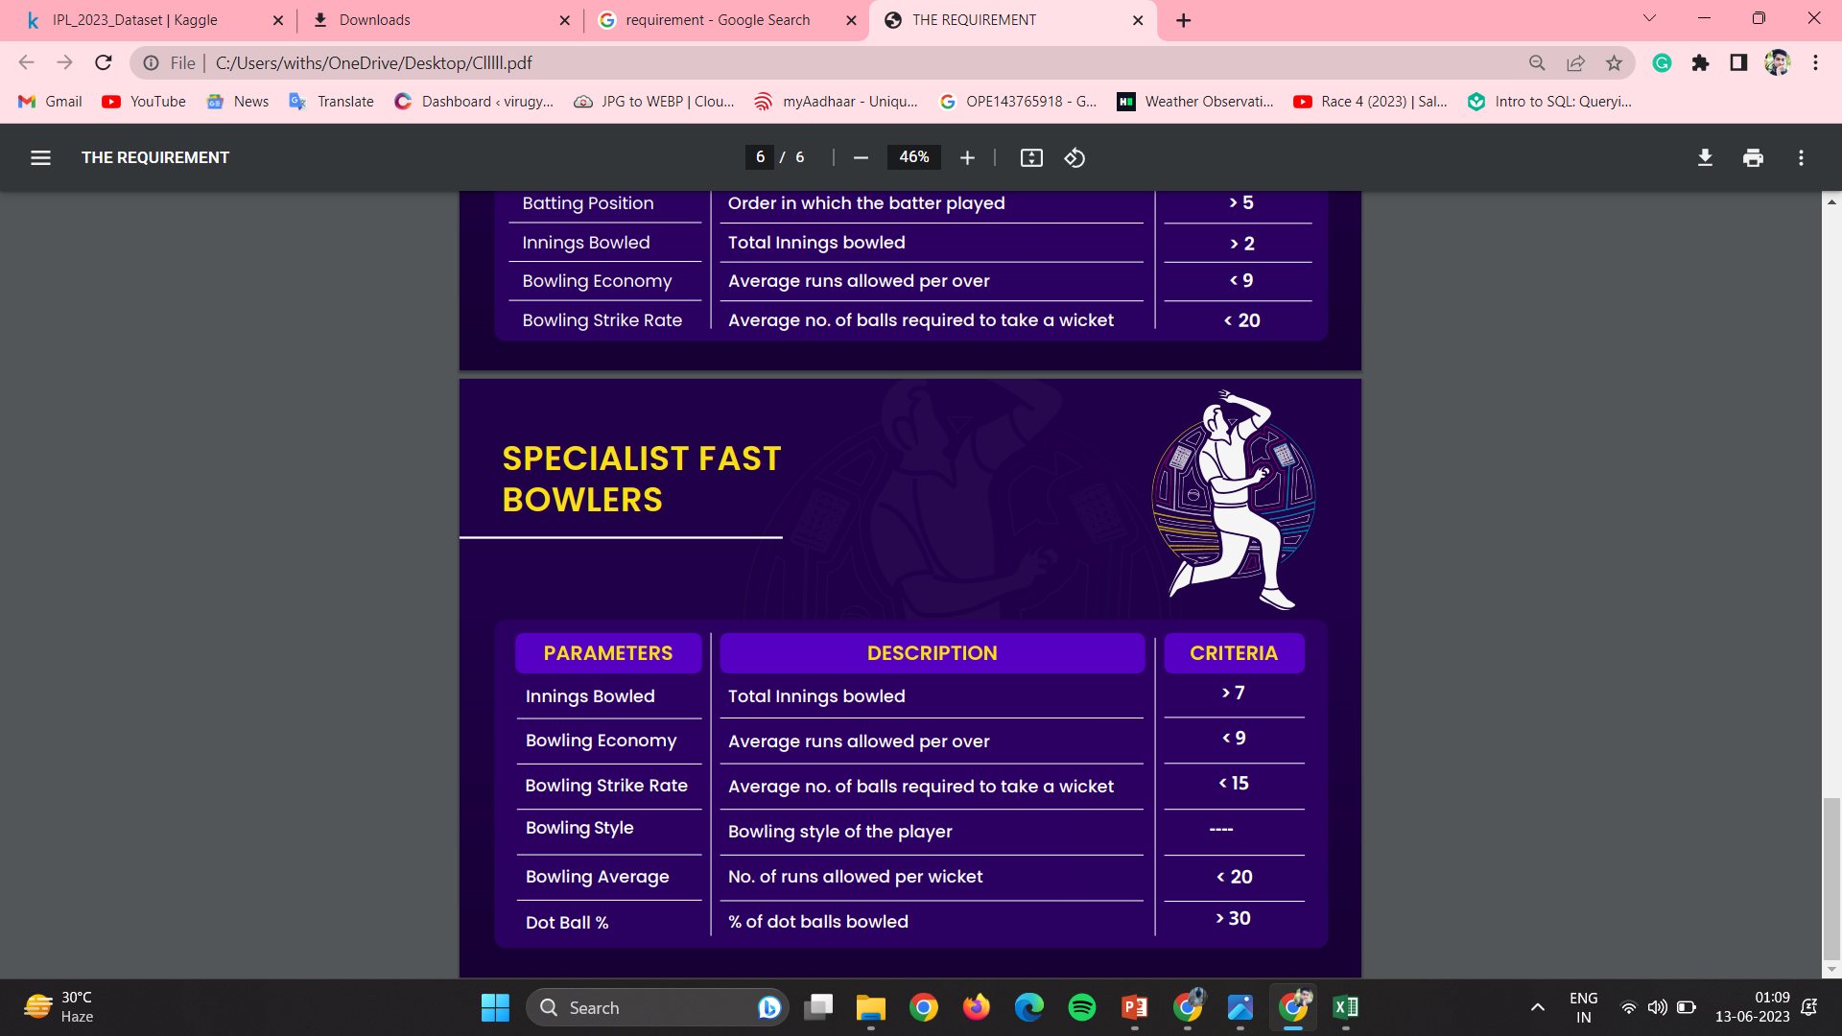
IPL 2023 DATA ANALYSIS
June - 2023
6

Slide 7
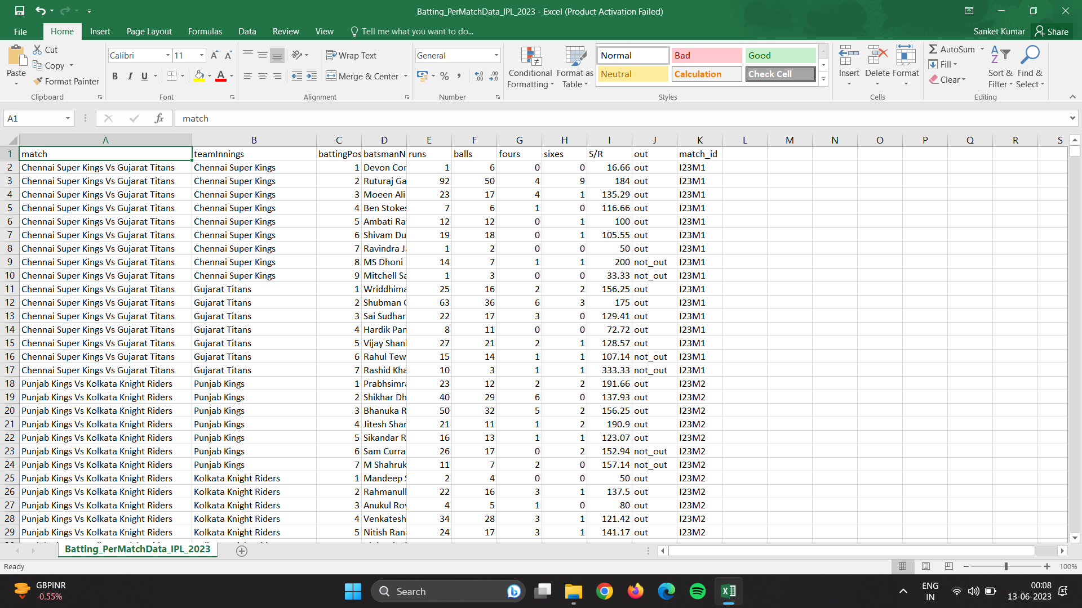

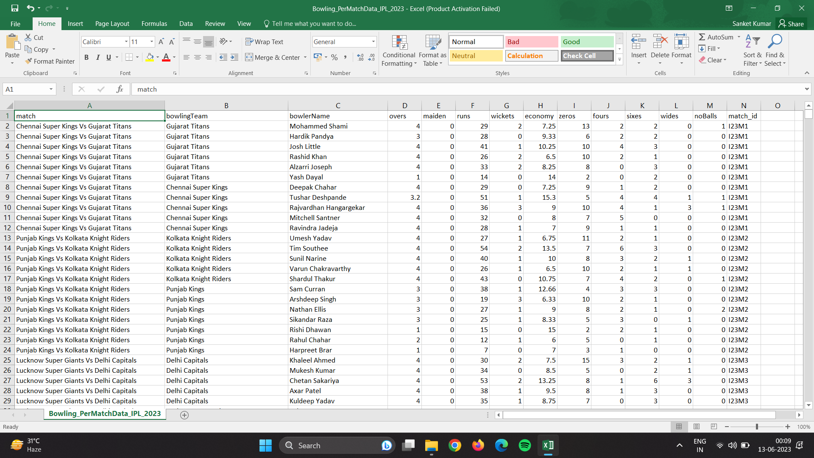
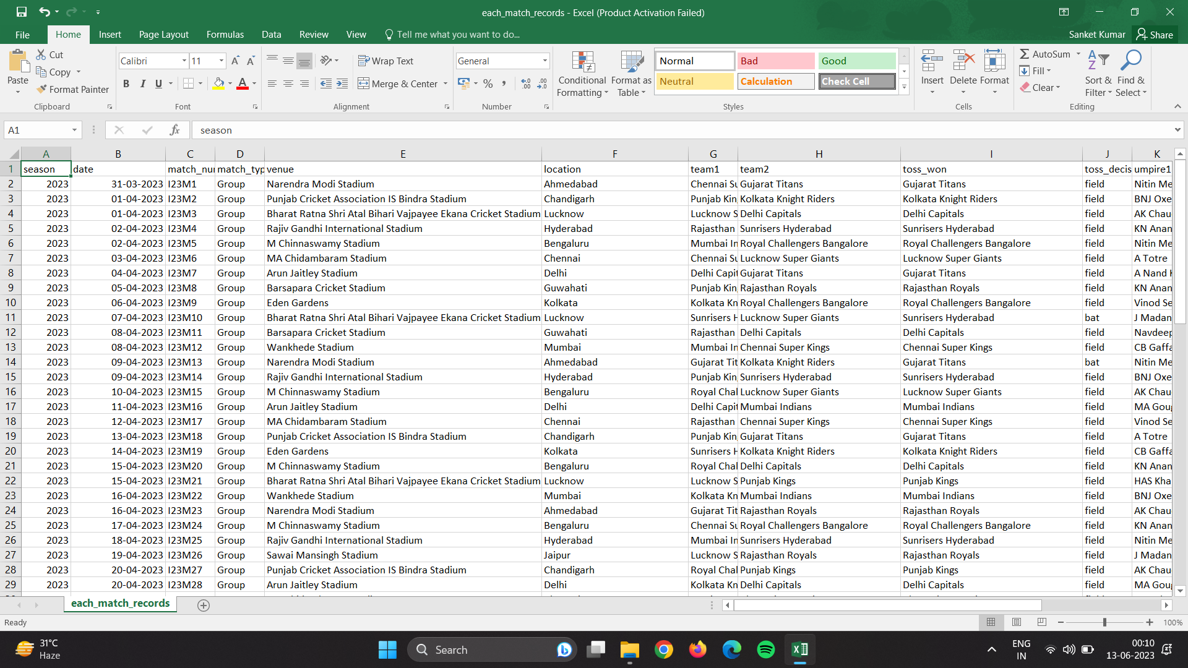
4. Data Sets
Batting Dataset
Match Summary
Bowling Dataset
IPL 2023 DATA ANALYSIS
June - 2023
7

Slide 8
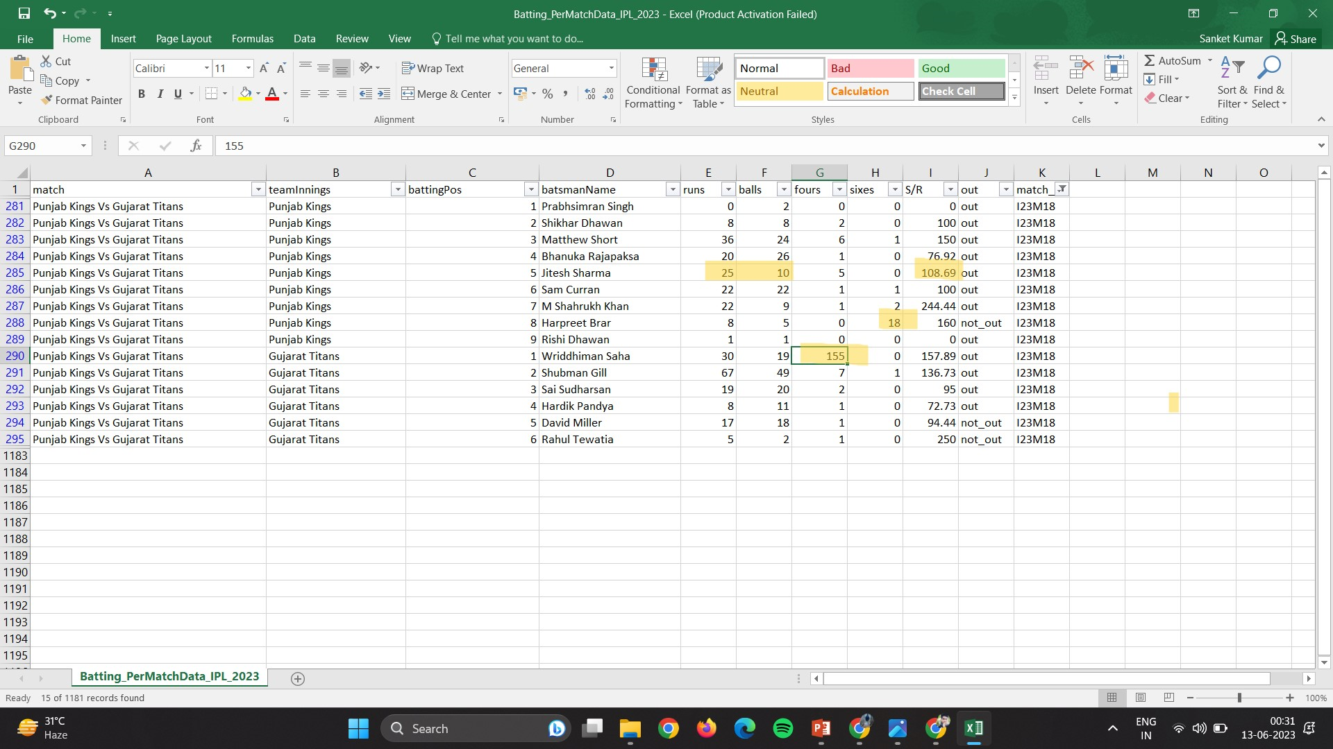
5. Data Cleaning
In data cleaning phase we clean the wrong data.
It is time taking Process.
In Match Number 18th we see that one man the name is Wriddiman saha smashed 155 fours in that match.
One man is hitting 18 sixes.
And some error also encounter
IPL 2023 DATA ANALYSIS
June - 2023
8

Slide 9
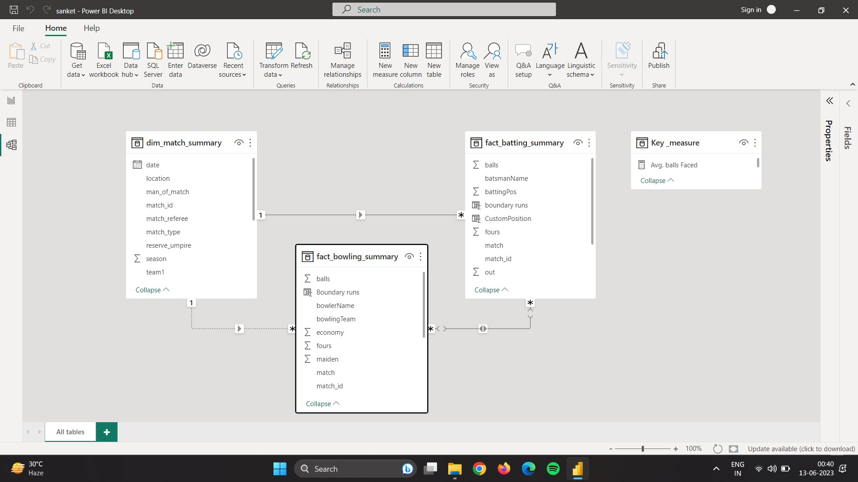
6. Data Modeling
Data Modeling is essential in every data analysis project here we make relationship with different table.
IPL 2023 DATA ANALYSIS
June - 2023
9

Slide 10
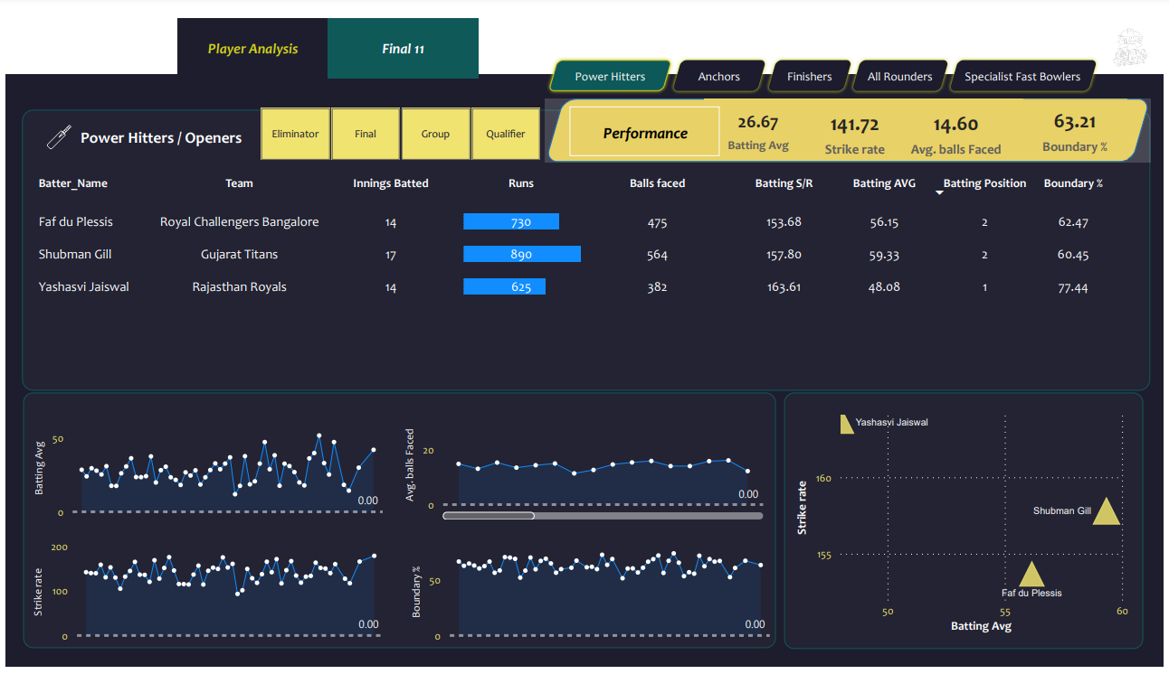
7.1 Analysis - Openers
IPL 2023 DATA ANALYSIS
10
June - 2023

Slide 11
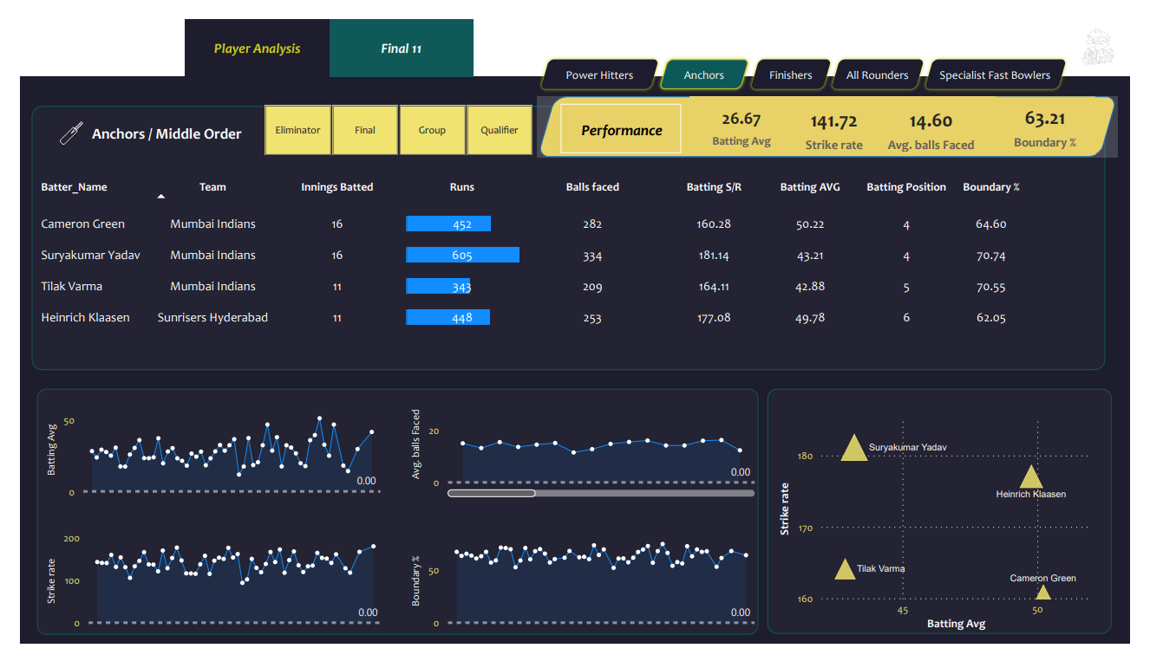
7.2 Analysis – Anchors
IPL 2023 DATA ANALYSIS
11
June - 2023

Slide 12
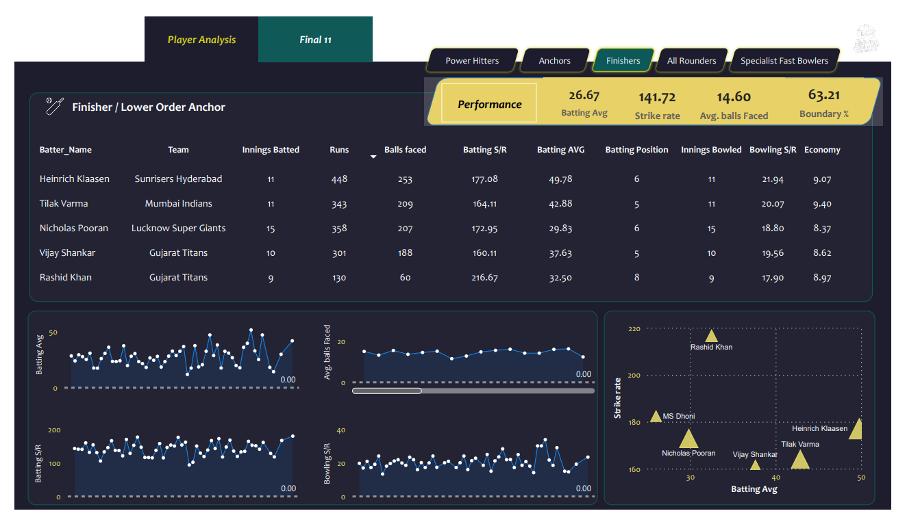
7.3 Analysis - Finishers
IPL 2023 DATA ANALYSIS
12
June - 2023

Slide 13
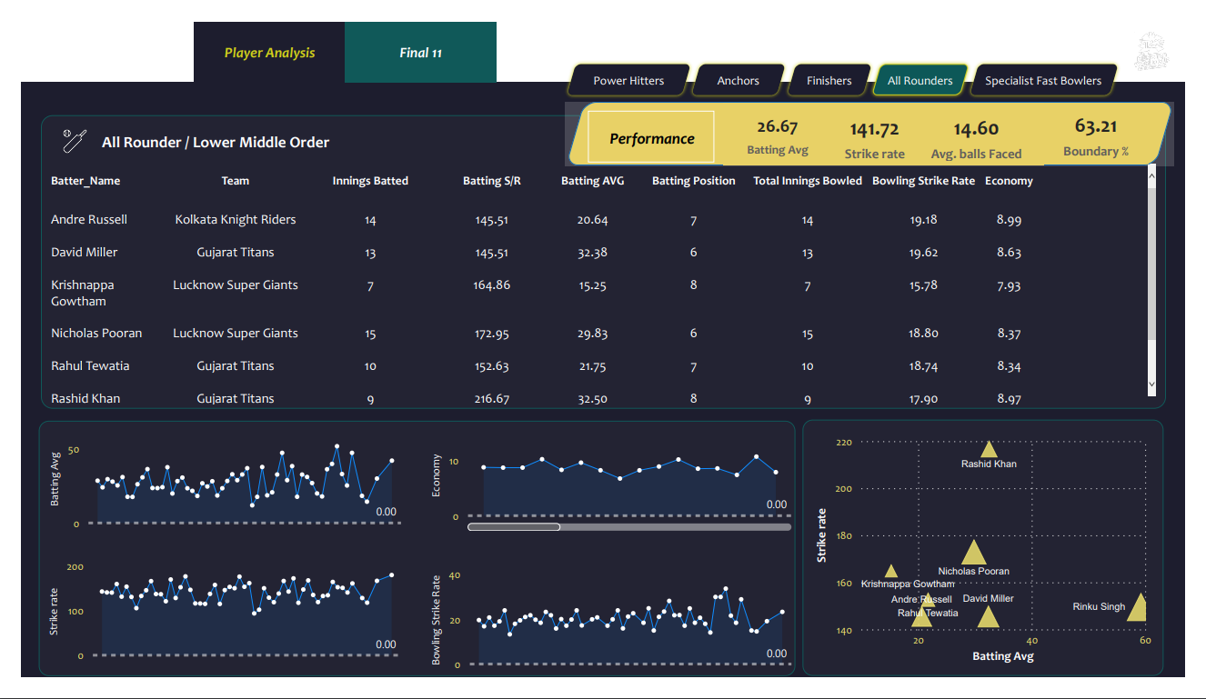
7.4 Analysis – All Rounders
IPL 2023 DATA ANALYSIS
13
June - 2023

Slide 14
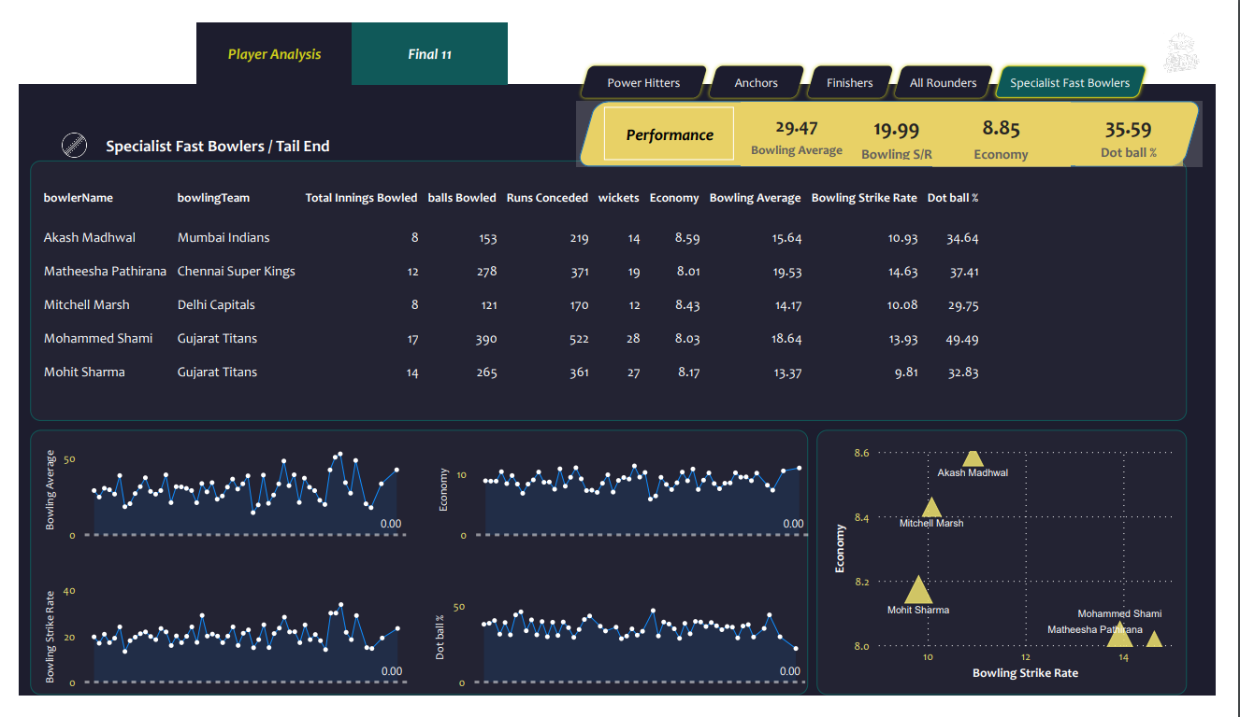
7.5 Analysis – Fast Bowlers
IPL 2023 DATA ANALYSIS
14
June - 2023

Slide 15
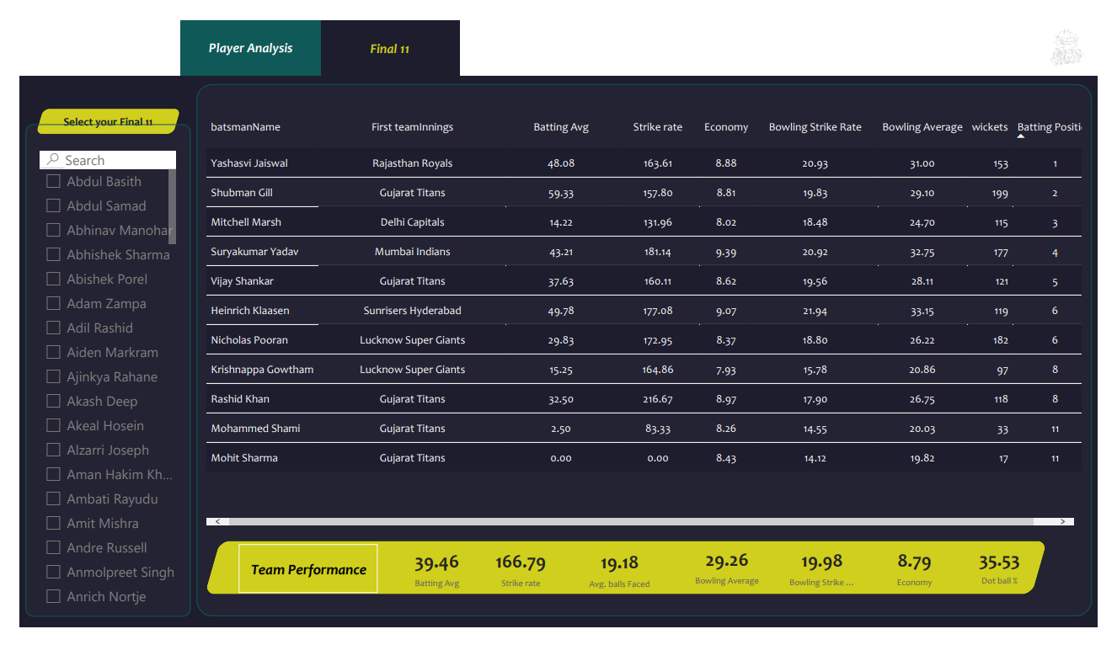
7.6 Final Result/Team
IPL 2023 DATA ANALYSIS
15
June - 2023

Slide 16
8. Conclusion
Through a comprehensive analysis of player performances in IPL 2023, the project successfully identified the top 11 players who exhibited exceptional skills in scoring more than 200 runs in a match while also defending targets of at least 180 runs. The analysis considered various factors such as batting strike rate, consistency, match situations, bowing economy, bowling strike rate, dot% and many more.
This Project Help to if who want to know who are the top 11 player of the IPL 2023.
The top 11 players highlighted in this analysis possess the qualities necessary to excel in high-scoring matches and successfully defend challenging targets. Their selection ensures a balanced team capable of achieving victory through dominant batting displays and effective bowling performances
IPL 2023 DATA ANALYSIS
June - 2023
16

Slide 17
14. References
Dataset from Kaggle.
Link_1 : https://www.kaggle.com/datasets/sankha1998/ipl2023
Link_2 : https://www.kaggle.com/datasets/purnend26/ipl-2023-dataset
2. Google Image(TATA IPL2023) : https://i0.wp.com/www.vpnranks.com/wp-content/uploads/2023/03/Watch-IPL-2023-outside-USA-on-Hulu-VR.jpg?strip=all
IPL 2023 DATA ANALYSIS
June - 2023
17

Slide 18


